Slide 1

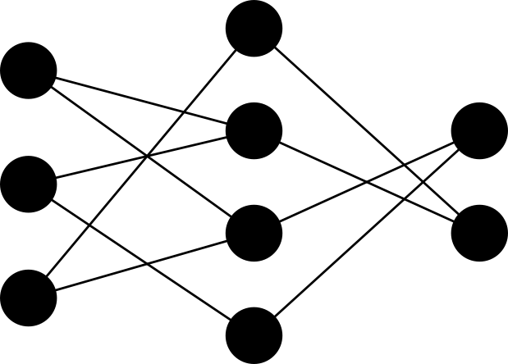

Exploring Complexity Reduction for Learning in Deep Neural Networks
Sourya Dey
PhD Qualifying Exam
April 23rd, 2019

Slide 2
Outline
Pre-Defined Sparsity
Introduction and Background
Hardware Architecture
Connection Patterns
Dataset Engineering
Model Search
Achieved Research Contributions
Proposed Research

Slide 3
Outline
Pre-Defined Sparsity
Introduction and Background
Hardware Architecture
Connection Patterns
Dataset Engineering
Model Search

Slide 4
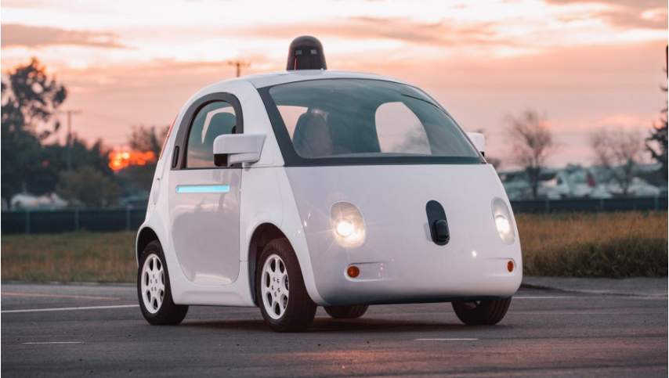

Introduction
Neural networks (NNs) are key machine learning technologies
Artificial intelligence
Self-driving cars
Speech recognition
Face ID
and more smart stuff …

Slide 5
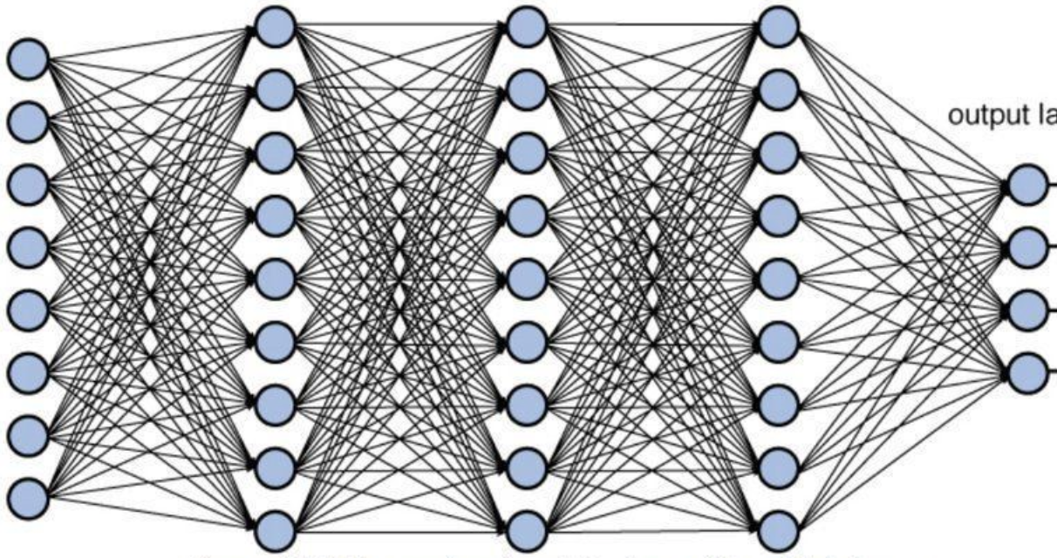

Overview
Modern neural networks suffer from parameter explosion
Training can take weeks on CPU
Cloud GPU resources are expensive
Our research reduces complexity of neural networks with minimal performance degradation

Slide 6
Summary of Contributions
Achieved:
Pre-defined sparsity to reduce complexity of neural networks
Hardware architecture to leverage pre-defined sparsity
Analyzing connection patterns and performance predicting measures
Proposed:
Better pipelining to improve hardware architecture
Family of synthetic datasets on Morse code with tunable difficulty
Architecture search of low complexity neural networks

Slide 7
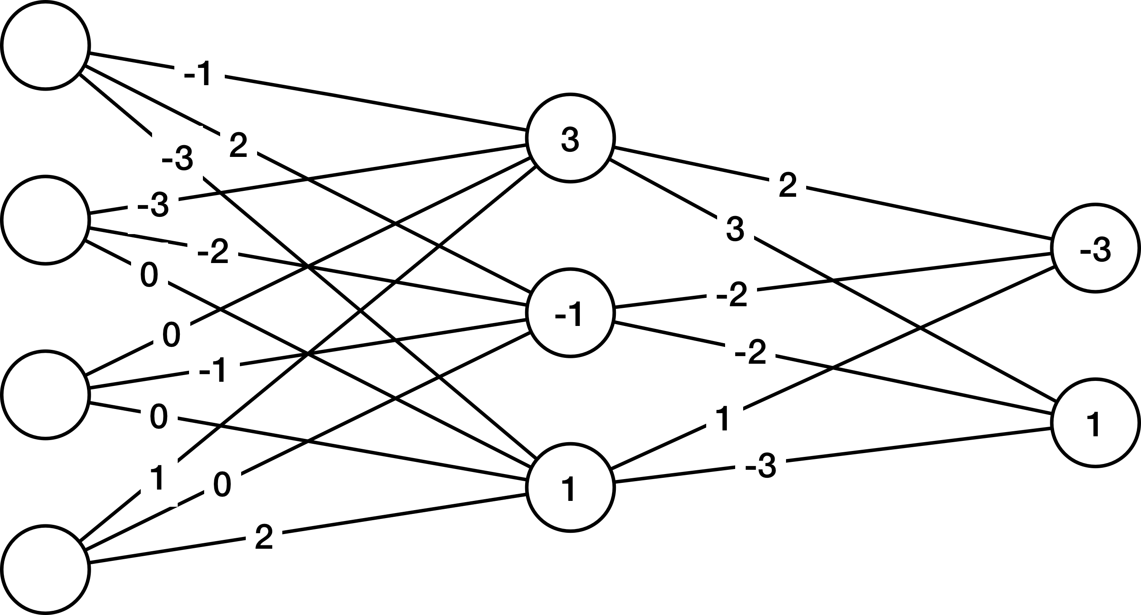
Notation
Multilayer Perceptron (MLP)
Junction 1
Layer 1
Junction 2
Layer 0
Layer L = 2
Fully connected (FC)
Trainable
Parameters
Weights
Biases

Slide 8
Neural Networks Operations for Classification
Training (training data)
Feedforward (FF)
Backpropagation (BP)
Update parameters (UP)
Inference (validation and test data)
Feedforward (FF) only
Test data performance used as metric for goodness of network

Slide 9
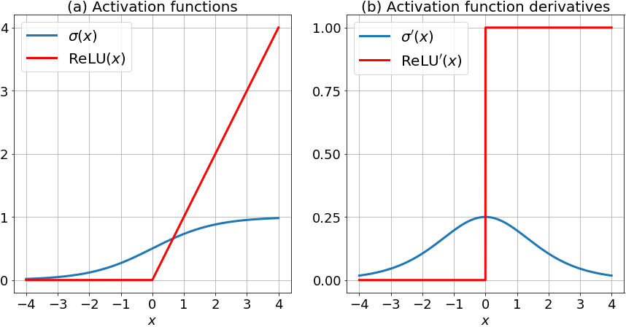
Feedforward (FF)
Previous layer activation
(Starts from input features a₀)
Linear output
Non-linear activation function
ReLU / Sigmoid for hidden layers
Softmax for output layer
Activation output
Activation derivative

Slide 10
Backpropagation (BP)
Ground truth labels
Typically one-hot for classification
Cross-entropy Cost
Delta (output layer)
Delta (intermediate layers)
Hadamard product
(element-wise multiplication)

Slide 11
Update (UP)
Training sample number
Learning Rate Hyperparameter
Gradient of cost w.r.t weights
Batch size
Gradient of cost w.r.t biases

Slide 12
The Complexity Conundrum
Storage Complexity - Dominated by weights
Computational Complexity - Also dominated by weights
A typical fully connected MLP for classifying MNIST handwritten digits has ~10⁵ weights
FF
BP
All the weights are used in all 3 operations
UP

Slide 13
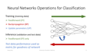
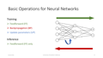
Existing methods to reduce Complexity
Algorithms
Gong 2014 – Vector quantization
ASIC Implementations
Han 2016 – Efficient Inference Engine
Reagen 2016 – Minerva
FPGA Implementations
Courbariaux 2016 - Binarized nets
Albericio 2016 – Cnvlutin
Chen 2015 – HashedNets
Aghasi 2017 – Net-trim
Zhang 2016 – Cambricon-X
Chen 2017 – Eyeriss
Ma 2018 – ALAMO
Training Focused
Girones 2005 – Pipelined on-line BP
Gomperts 2011 – Parametrized FPGA-based NNs
Wang 2017 – DLAU
Sindhwani 2015 – Structured transforms
Srinivas 2017 – Special regularizers
Chen 2014 – Diannao
Suda 2016 – Open-CL based
These reduce parameters during inference, but training complexity remains intensive
These focus on training, but do not delete parameters
Notes:
We have been inspired by Girones 2005

Slide 14
Outline
Pre-Defined Sparsity
Introduction and Background
Hardware Architecture
Connection Patterns
Dataset Engineering
Model Search
Achieved Research Contributions

Slide 15
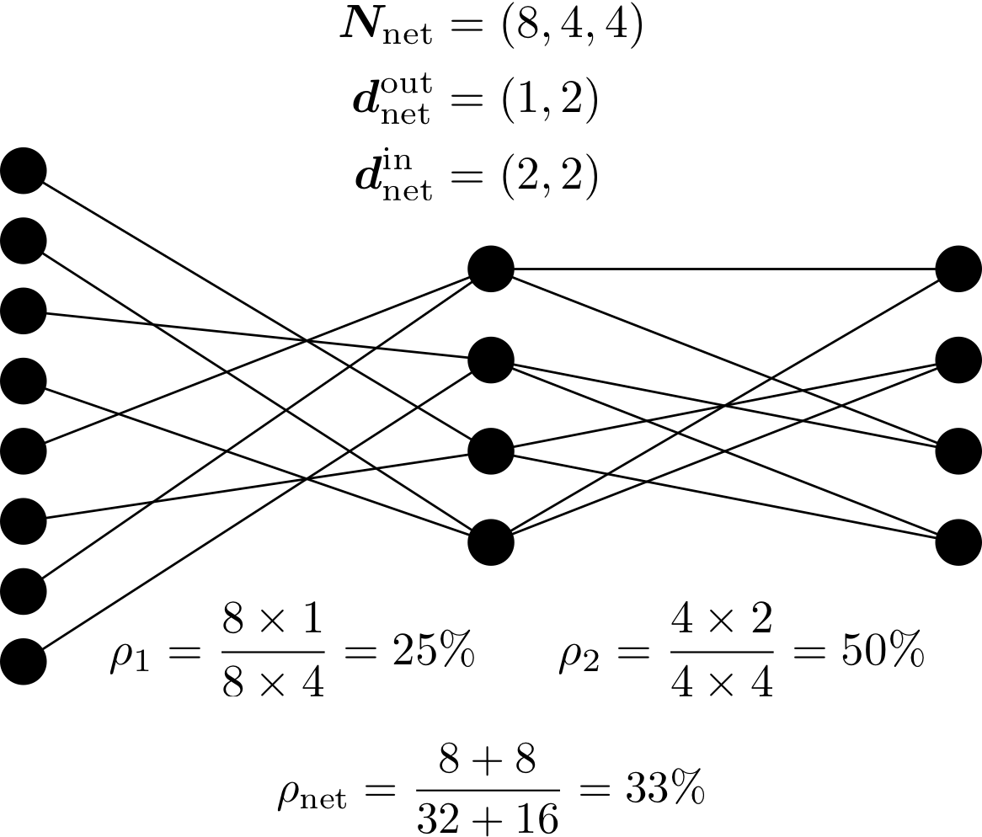
Our Work: Pre-defined Sparsity
Structured Constraints: Fixed in-, out-degrees for every node
Pre-define a sparse connection pattern prior to training
Use this sparse network for both training and inference
Reduced training and inference complexity
Junction Densities
Overall Density

Slide 16
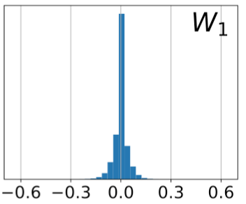
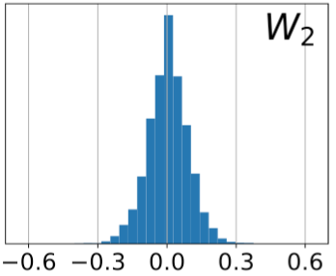
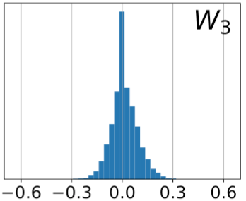
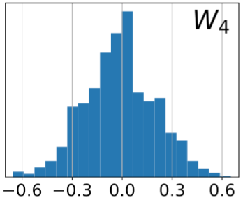
Motivation behind pre-defined sparsity
In a FC network, most weights are very small in magnitude after training

Slide 17
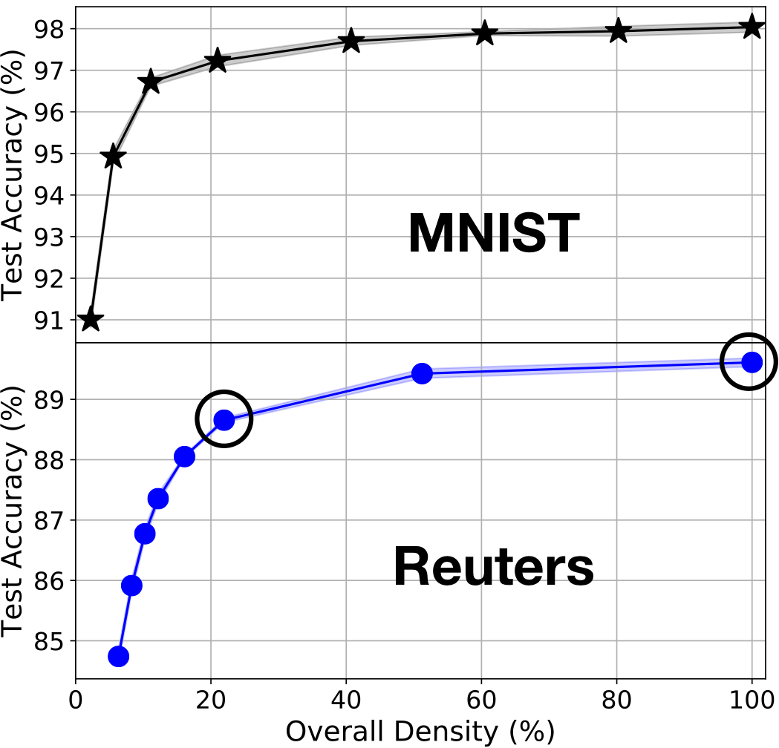
Performance of pre-defined sparsity
Starting with an MLP with only 20% of parameters compared to fully connected : Classification accuracy reduction on test data is <1%

Slide 18
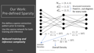
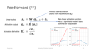
Computational Savings
In-degree summations for each node in FF
Out-degree summations for each node in BP
Only node pairs (j,k) which have weight connecting them in UP
For all 3 operations – FF, BP, UP – only use weights which are present

Slide 19
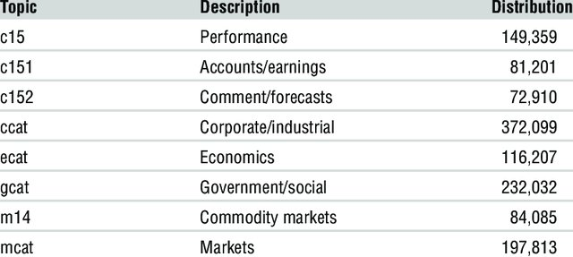

Designing pre-defined sparse networks
A pre-defined sparse connection pattern is a hyperparameter to be set prior to training
How can it be set?
We experimented on several datasets:
MNIST handwritten digits
Reuters RCV1 corpus of newswire articles
TIMIT speech corpus (only MLP portion)
CIFAR-10 and -100 images (CNN + MLP)
Morse Code symbols (described later)
Pic courtesy: https://www.researchgate.net/publication/3454183_Hybrid_Neural_Document_Clustering_Using_Guided_Self-Organization_and_Wordnet/figures?lo=1

Slide 20
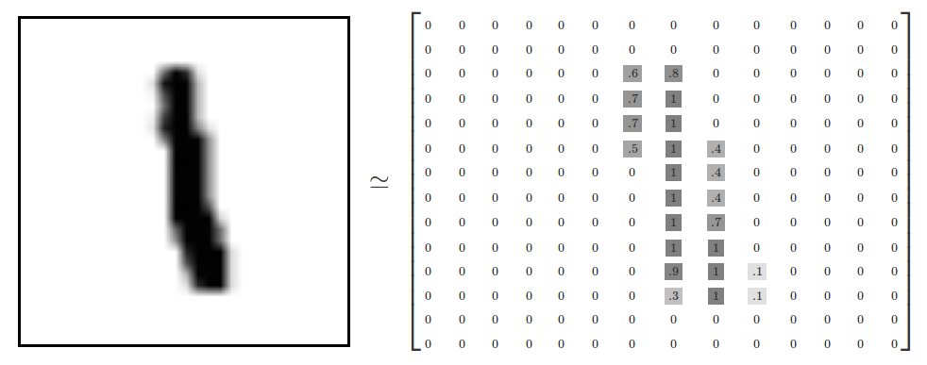
Dataset Redundancy
Most datasets have too many features => Can be reduced
MNIST:
Default: 784 features (image pixels)
Principal component analysis to reduce to 200 => Less redundancy
Reuters:
Default: Collect 2000 tokens (word snippets) as features from each article
Can be reduced to 400 => Less redundancy
TIMIT:
Default: Collect 39 MFCCs as features
Decrease by 3x to 13 => Less redundancy
Increase by 3x to 117 => More redundancy
CIFAR:
Default: Pre-process using a deep 9-layer CNN
Simplify to a 2-layer CNN => Less redundancy
Pic courtesy: https://tensorflow.rstudio.com/tensorflow/articles/tutorial_mnist_beginners.html

Slide 21
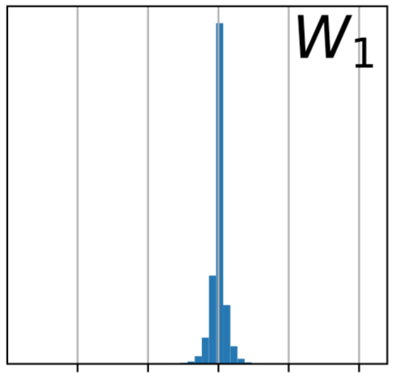
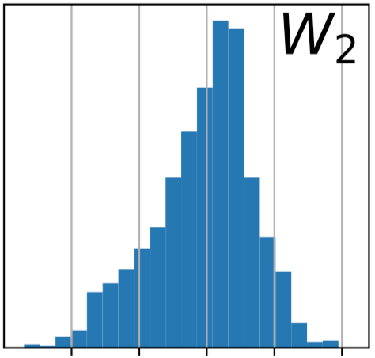
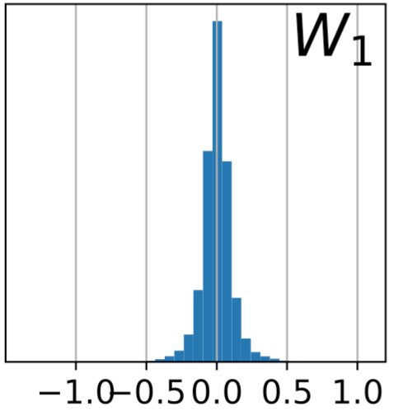
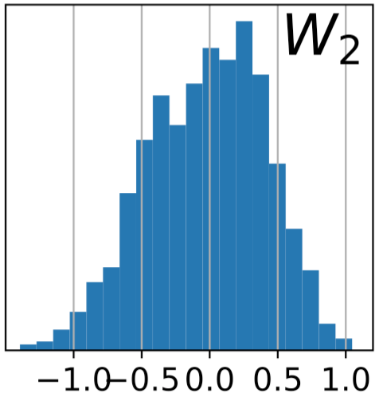
Effect of redundancy on sparsity
MNIST with default 784 features
Less redundancy => Less sparsification possible
MNIST reduced to 200 features
Wider spread

Slide 22
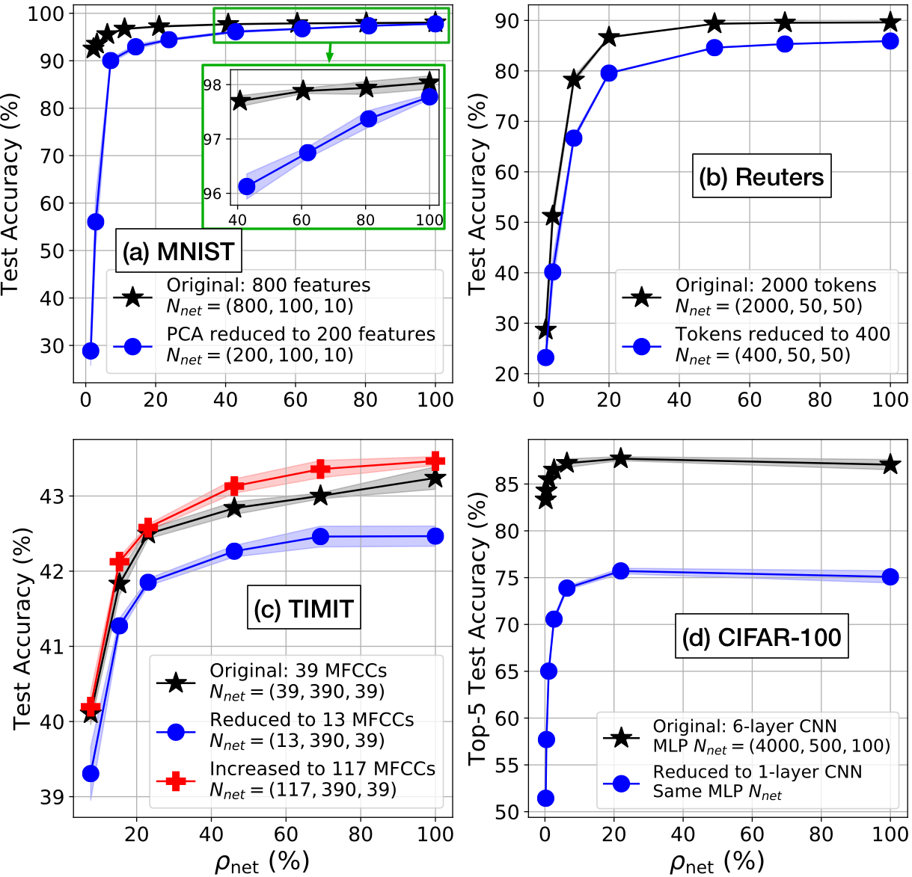
Effect of redundancy on sparsity
Reducing redundancy leads to performance starting to degrade at higher densities

Slide 23
Individual junction densities
Latter junctions (closer to the output) need to be denser

Slide 24
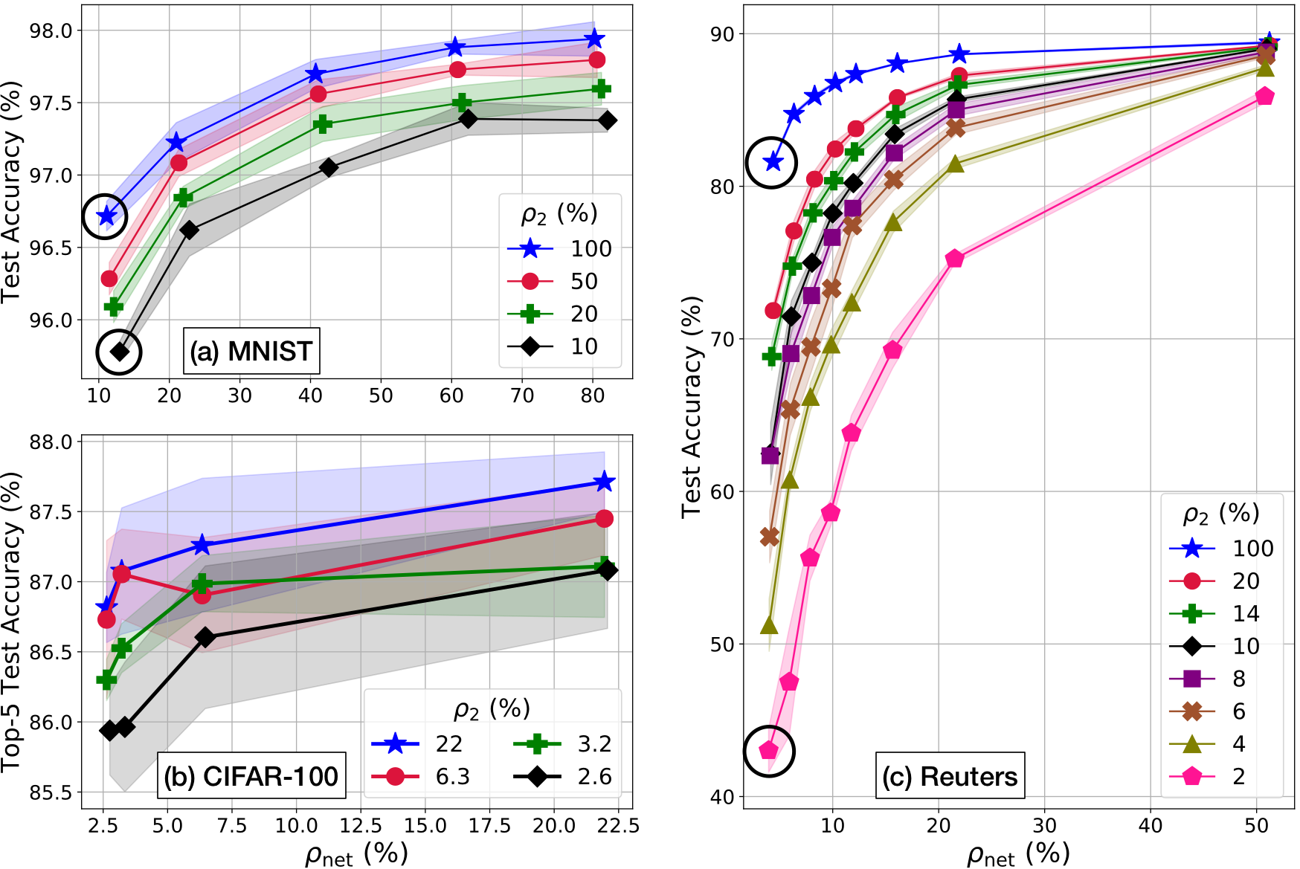
Individual junction densities
Each curve keeps 𝜌₂ fixed and varies 𝜌_{net} by varying 𝜌₁
For the same 𝜌_{net} , 𝜌₂ > 𝜌₁ improves performance
Similar trends observed for deeper networks, with few exceptions
Notes:
focus on circled points on same vertical line

Slide 25
‘Large sparse’ vs ‘small dense’ networks
A sparser network with more nodes will outperform a denser network with less nodes, when both have same number of trainable parameters (weights+biases)
…unless density of the larger network goes lower than a critical density (problem dependent)

Slide 26
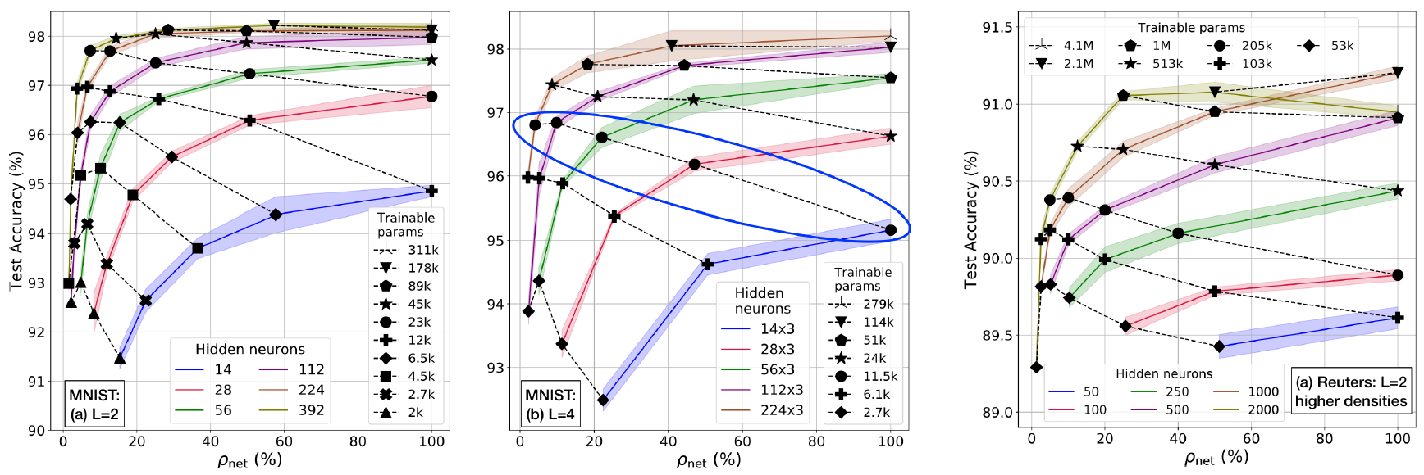
‘Large sparse’ vs ‘small dense’ networks
Networks with same number of parameters go from bad to good as #nodes in hidden layers is increased
Below critical density
Notes:
L means number of layers after input

Slide 27
Regularization
Overall Density | λ
100 % | 1.1 x 10⁻⁴
40 % | 5.5 x 10⁻⁵
11 % | 0
Regularized cost
Original unregularized cost (like cross-entropy)
Example for MNIST 2-junction networks
Regularization term
Pre-defined sparsity reduces the overfitting problem stemming from over-parametrization in big networks
Pre-defined sparse networks need smaller λ (as determined by validation)
Notes:
and don’t just have a small network. remember large sparse is better than small dense

Slide 28

Summary of pre-defined sparsity – Trends and design guidelines
Exploits redundancy in dataset
Later junctions need more density
‘Large and sparse’ networks are better than ‘small and dense’ networks
Alternative to regularization
Most networks can be significantly sparsified!
... these tie in with proposed research on model search

Slide 29
Outline
Pre-Defined Sparsity
Introduction and Background
Hardware Architecture
Connection Patterns
Dataset Engineering
Model Search
Achieved Research Contributions

Slide 30
Hardware Architecture
We built a customized hardware architecture to leverage pre-defined sparsity
Key highlights:
Edge-based
Customizable amount of parallelism
Clash free memory accesses
Pipelined processing

Slide 31
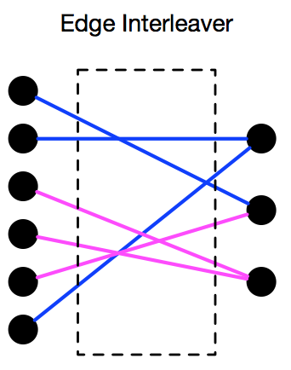
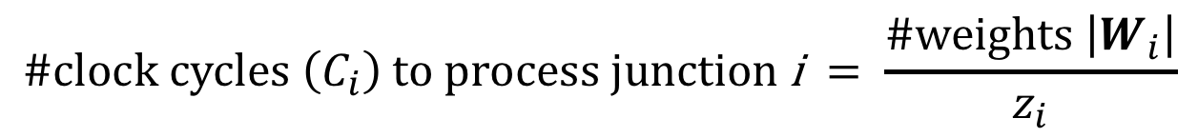
Degree of parallelism z
z_{i} = #edges (weights) processed in parallel in junction i
$$\text{\#}\text{clock} \text{cycles} \left(C_{i}\right) \text{to} \text{process} \text{junction} \text{i} = \frac{\#weights \left|W_{i}\right|}{z_{i}}$$
Computational complexity depends only on z_{i}
Decouple hardware required from network complexity
Slow
Training
z
Hardware
Intensive
Example z_{i} = 3
Flexibility

Slide 32
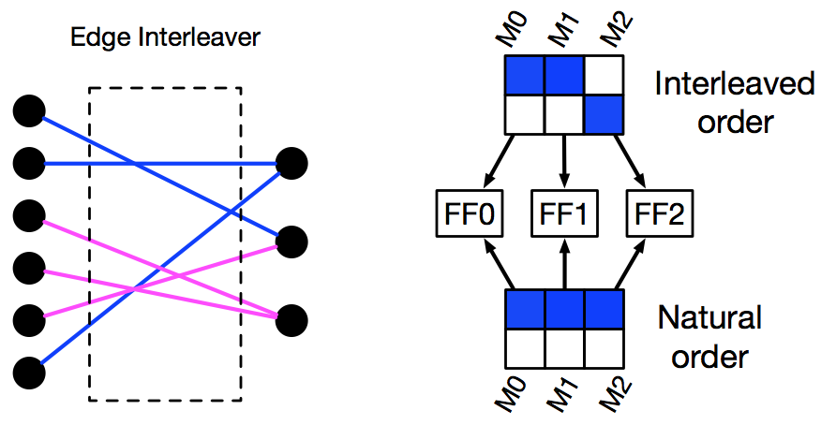
Memory organization and clash freedom
z_{i} memories for storing each variable – a, h’, δ, W, b – in each junction
Left side nodes are accessed in arbitrary order due to interleaving
Weights are accessed one row at a time (natural order)
Must access each memory no more than once per clock cycle, otherwise clash => processing stall
Example z_{i} = 3
Notes:
point out that each vertical column has just 1 shaded cell

Slide 33
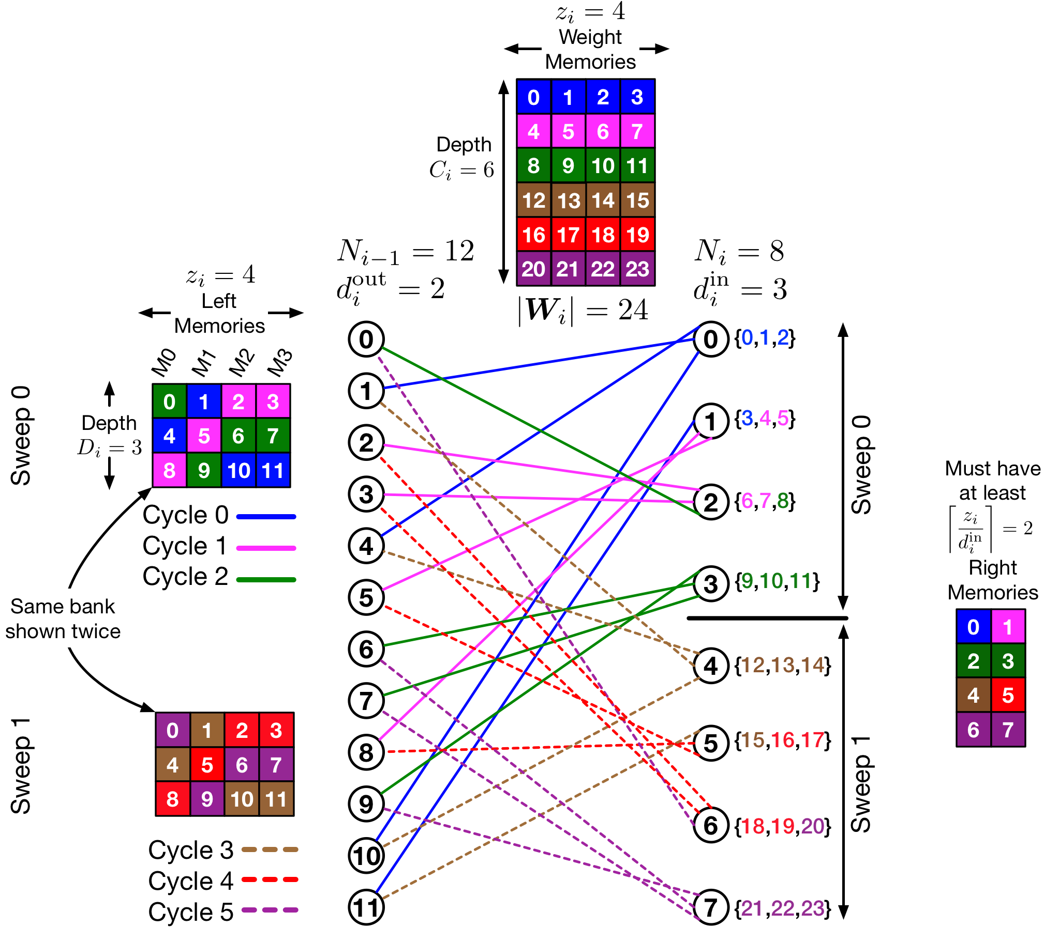
Memory organization of a single junction
z_{i} = 4 weights accessed per cycle
Must access all 4 left memories exactly once per cycle for clash-freedom
After D_{i} = 3 cycles, all left nodes are accessed once => 1 sweep
Repeat for d_{i}^{out} = 2 sweeps to access all weights
At most 2 right nodes accessed per cycle => At least 2 right memories required for clash-freedom

Slide 34
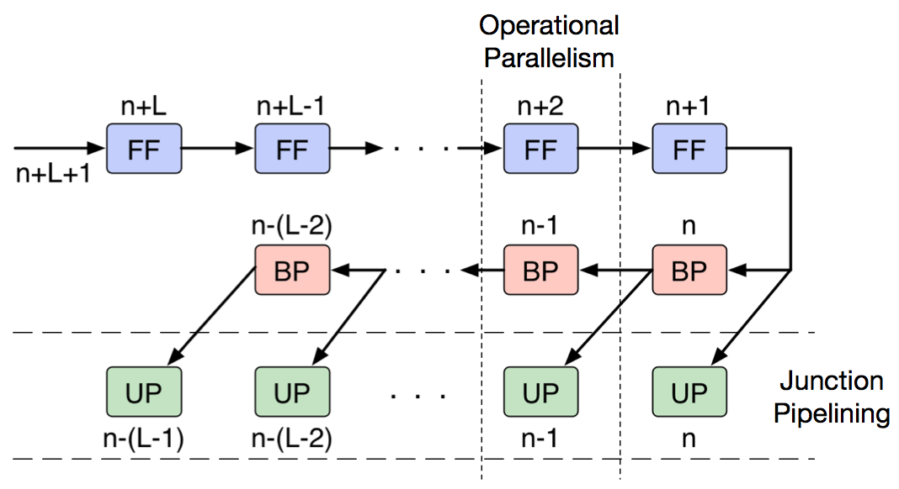
Parallel and Pipelined processing
Operational parallelism: FF, BP, UP simultaneously inside a junction
Junction pipelining: Each operates on different inputs across junctions
Faster training @ more hardware and storage cost
Notes:
mention that n+2 etc are input sample numbers

Slide 35
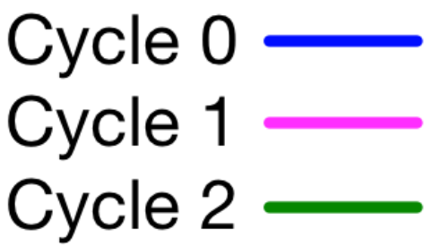
Clash-free memory access patterns
Left node number
Mem 0
Mem 1
Mem 2
Mem 3
Storage: z_{i}-length seed vector
Computation: z_{i} incrementers
Can have richer classes of memory access patterns @ more hardware cost
Loc 0
0
1
2
3
Loc 1
4
5
6
7
Loc 2
8
9
10
11
N_{i-1} = 12 left side nodes arranged in z_{i} = 4 memories
Fix a seed vector = (1,0,2,2) for starting cycle 0 locations
For consecutive cycles, add 1 modulo memory depth

Slide 36
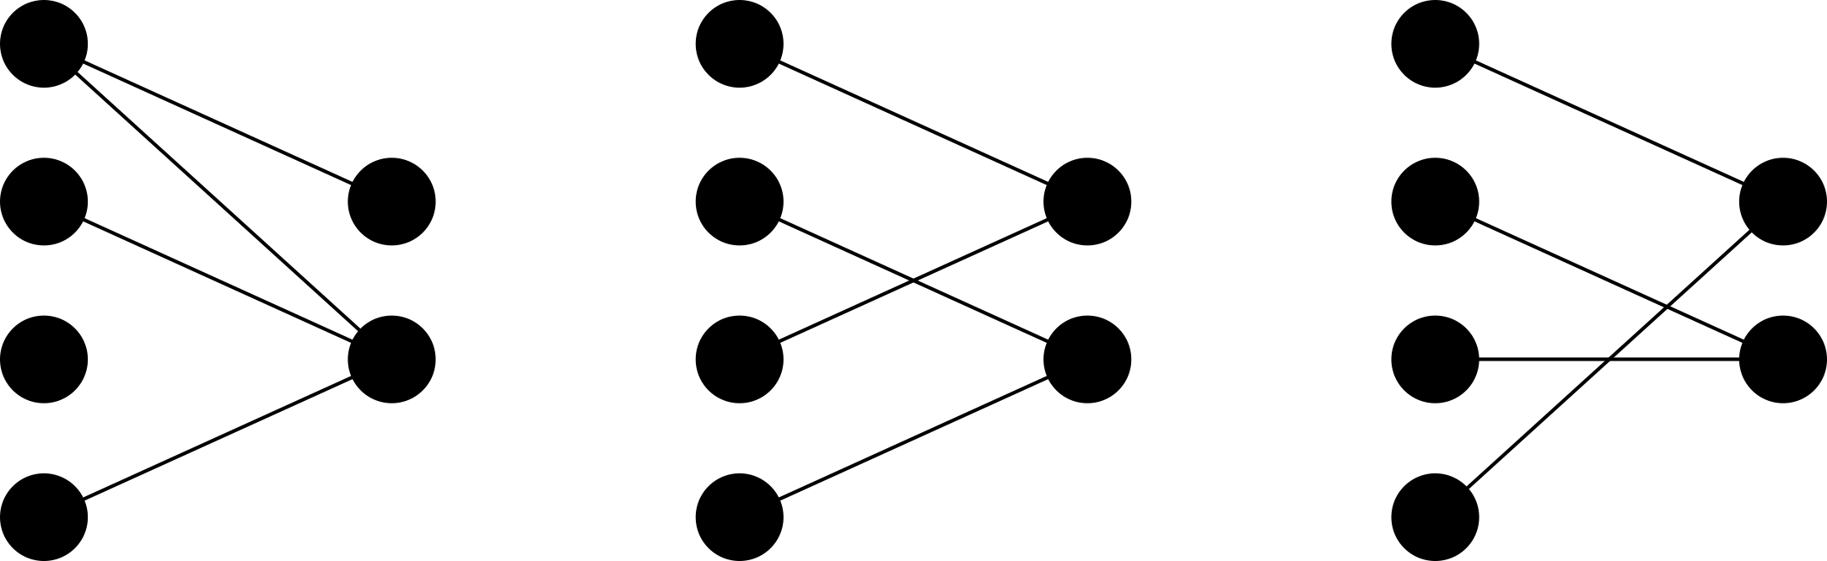
Types of pre-defined sparsity
Randomly distribute connections given overall density
Structure the network to have constant in- and out-degree for each node
Fix z and structure the connections for hardware-friendly clash-free memory accesses
Random → Structured → Clash-free
progressively restricts the network

Slide 37
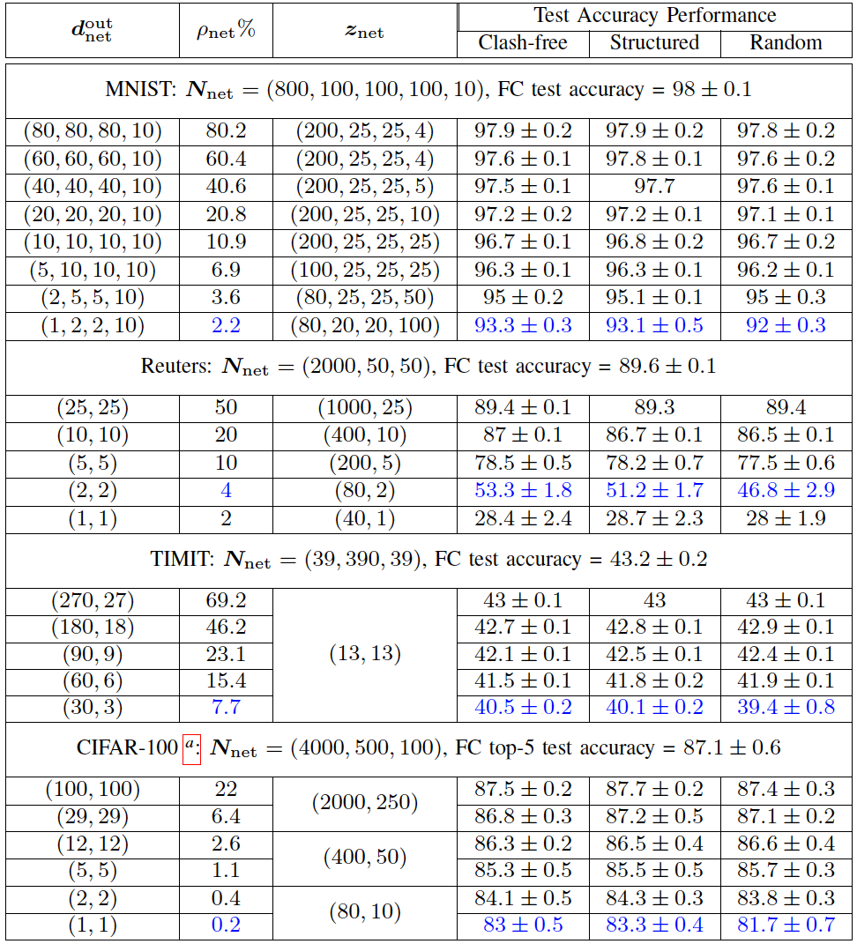
Performance Comparison
Hardware-friendly simple clash-free patterns can improve performance
Random sparsity can perform badly
:
Notes:
explain doutnet means total out-degree, znet is z for all junctions, and for CIFAR-100, Nnet is only for MLP portion after CNN
reuters keeps same #cycles for all cases, timit keeps same z

Slide 38
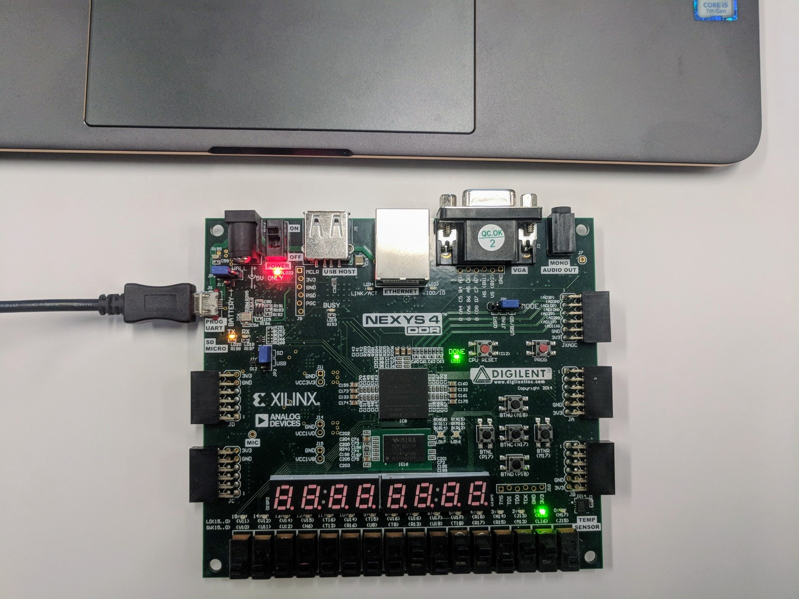
FPGA Implementation
Initial hardware prototype of pre-defined sparse 2-junction network training on MNIST
Nodes = 1120
Weights = 5120
Overall density = 7.5%
Total parallelism = 160
Xilinx Artix-7 FPGA on Digilent Nexys4 board

Slide 39
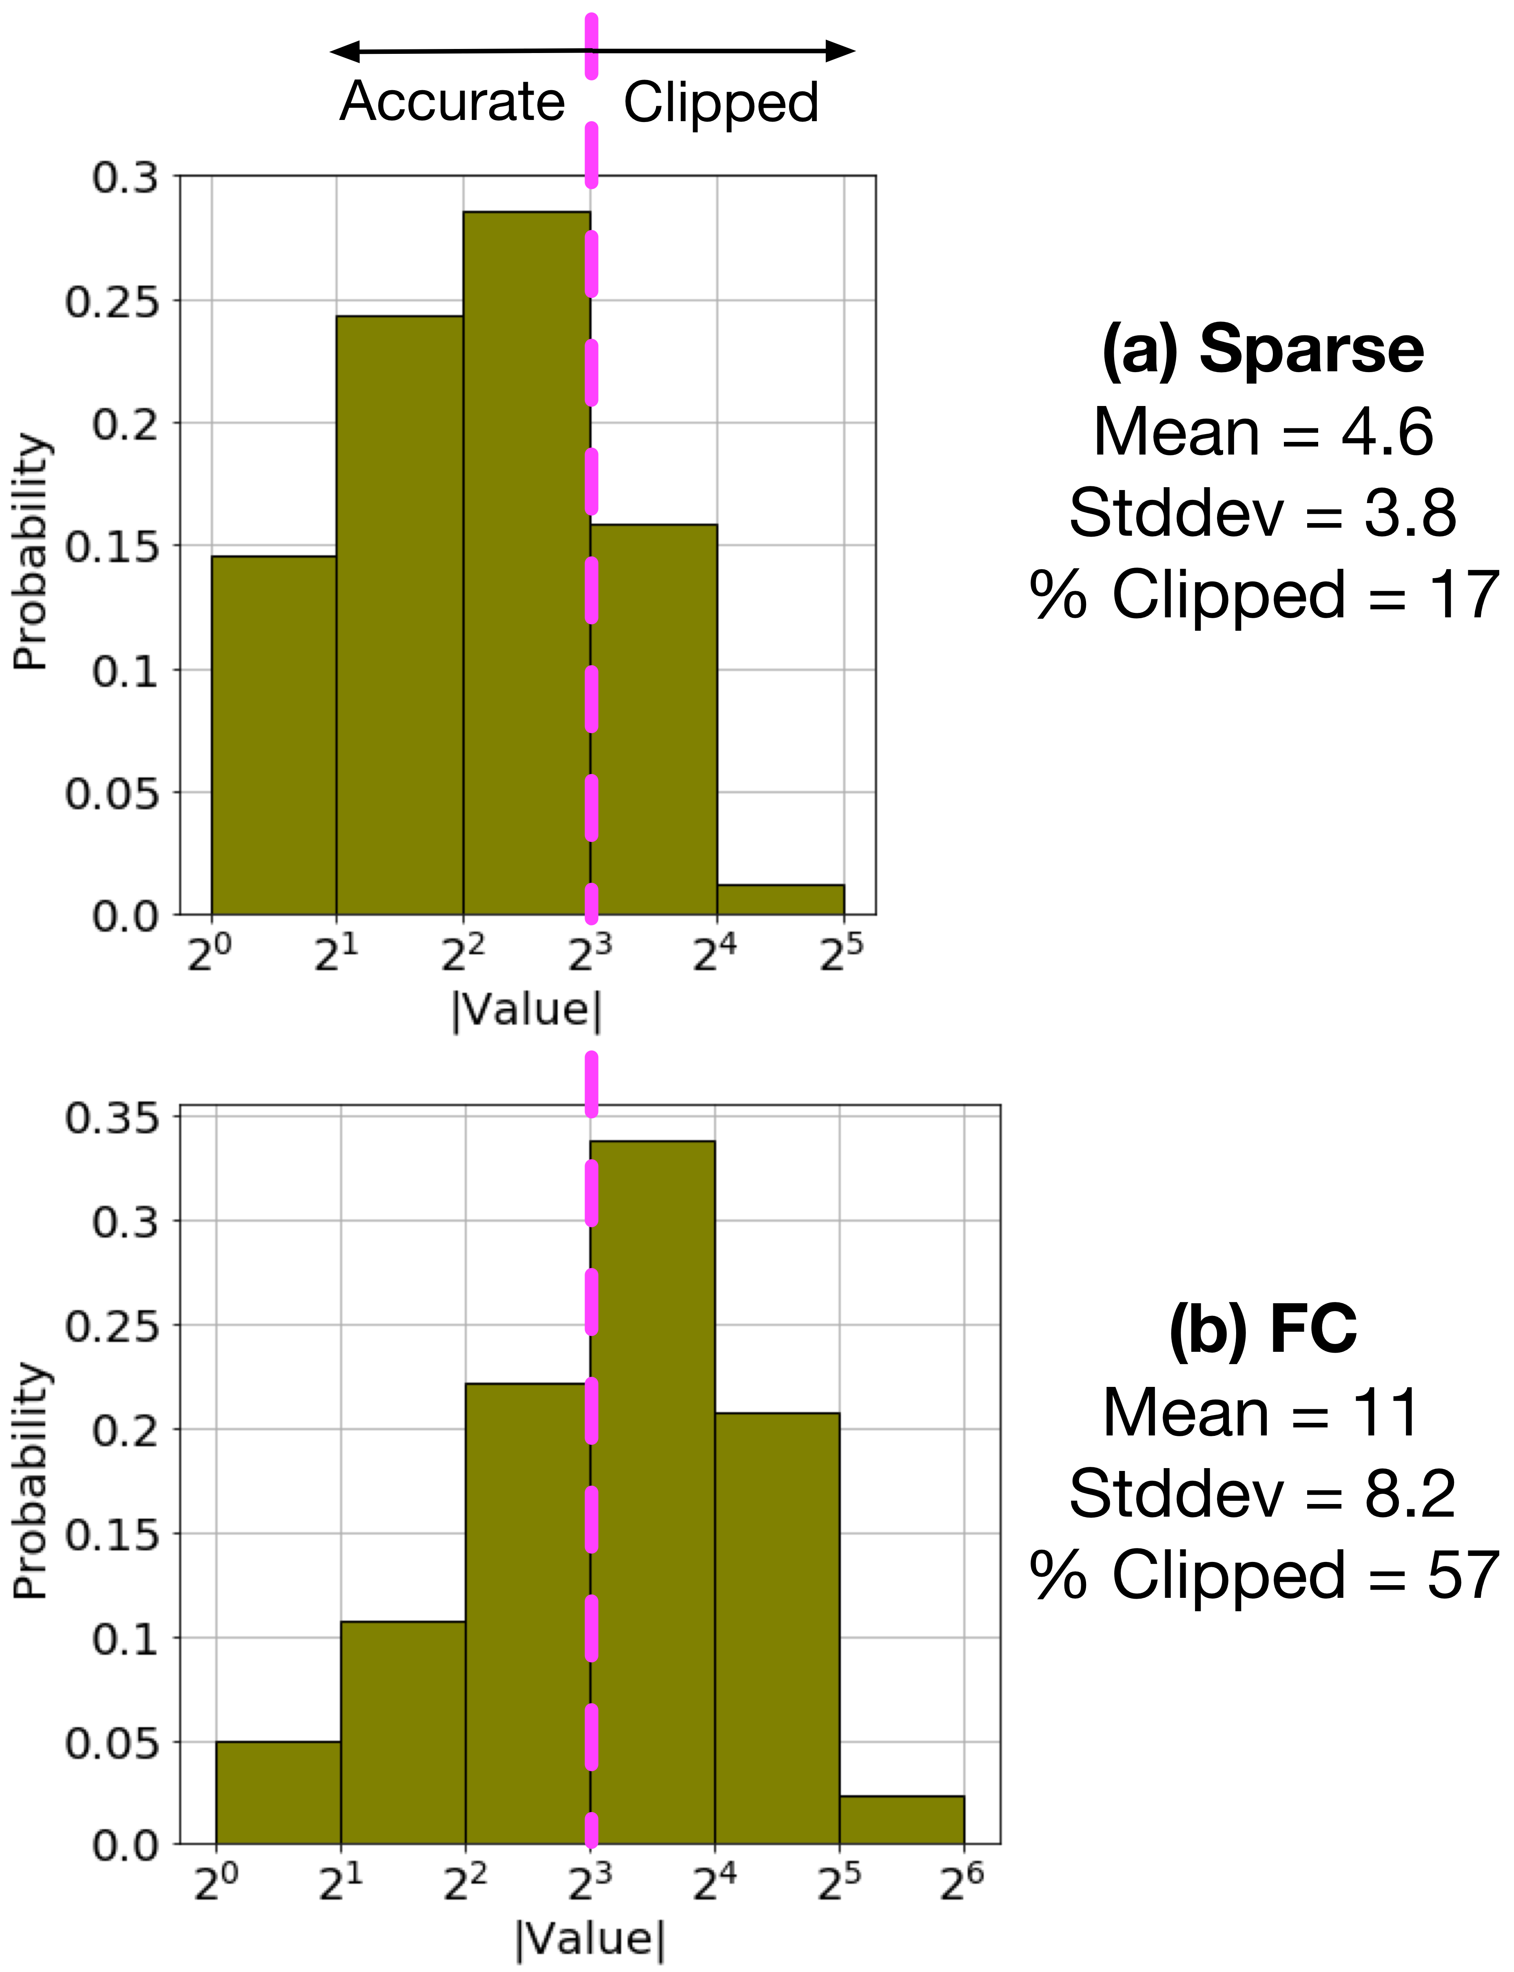
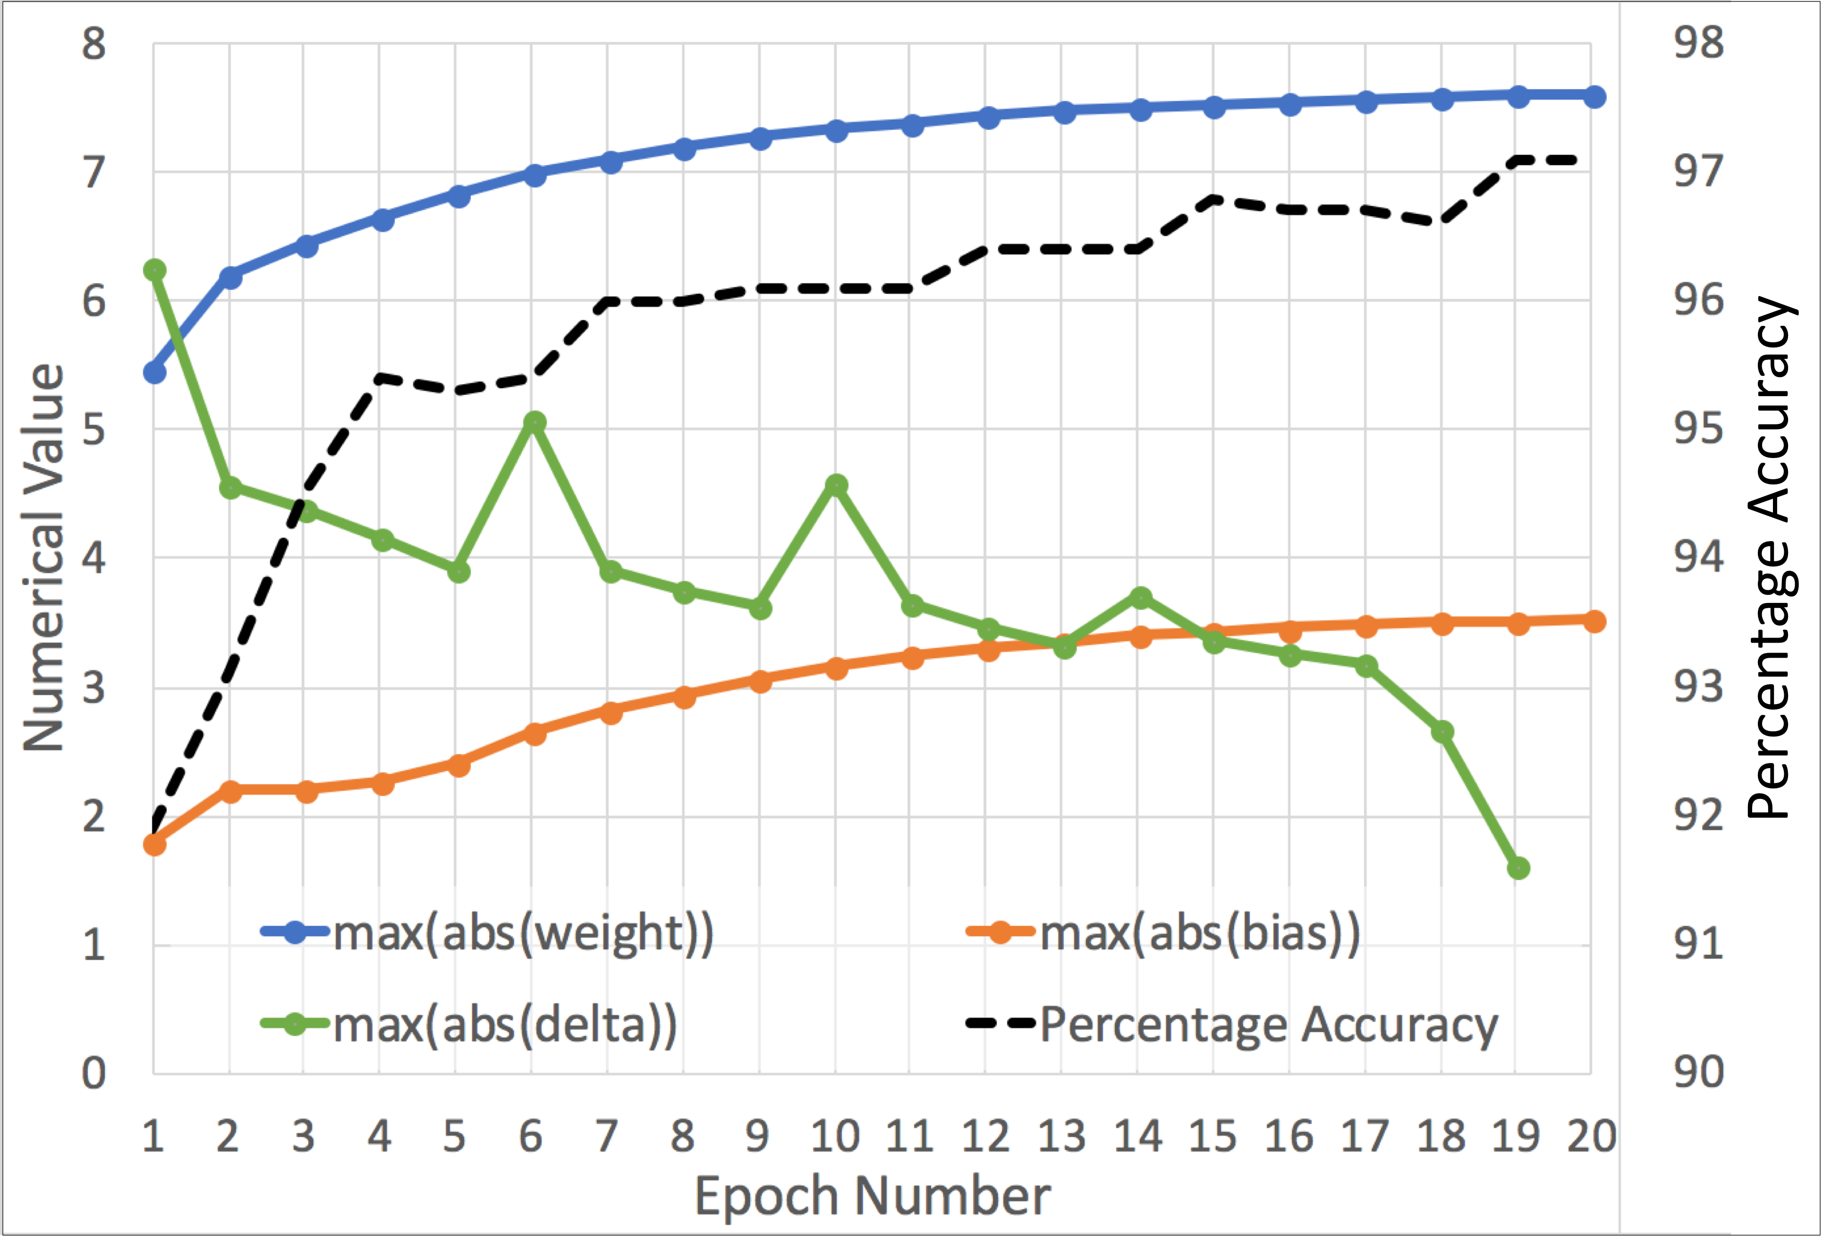
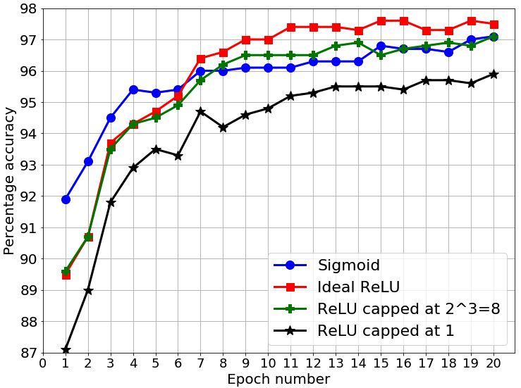
Some Findings and Considerations
a₁ histograms
Sigmoid activation works better in hardware than ReLU
12-bit fixed point config:
(sign, integer, fractional) = (1,3,8)
Dynamic range is reduced due to pre-defined sparsity

Slide 40
Ongoing / Future Work in H/W Implementation
This dissertation:
More pipelining to improve speed (current clock frequency = 15 MHz)
Other members of our team:
Better memory interfacing and management protocols
Leveraging cloud FPGA resources to support bigger networks

Slide 41
Outline
Pre-Defined Sparsity
Introduction and Background
Hardware Architecture
Connection Patterns
Dataset Engineering
Model Search
Achieved Research Contributions

Slide 42
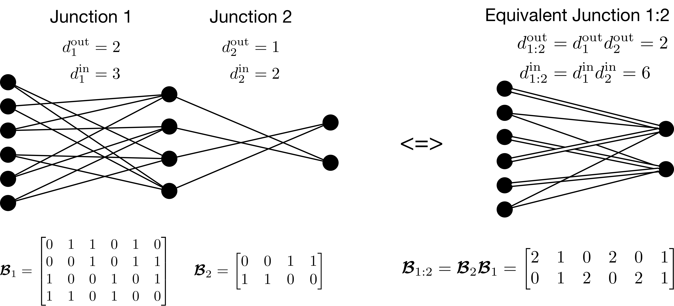
Biadjacency Matrices

Slide 43
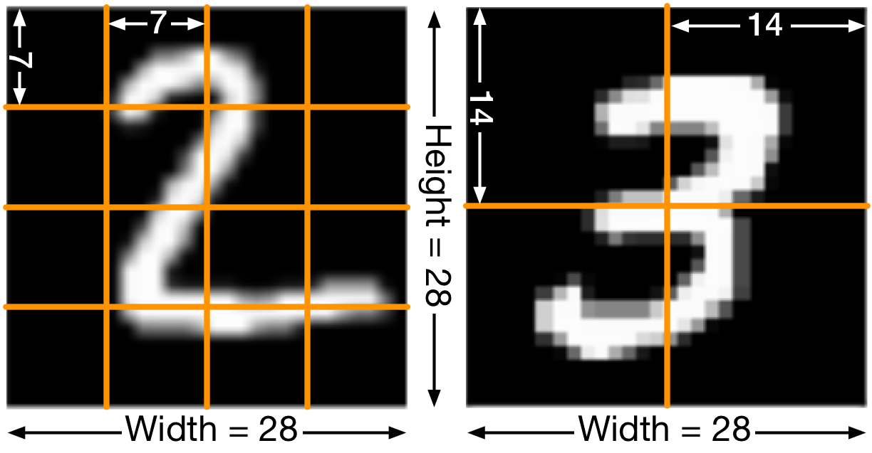
Windowed connection patterns
For best results, nodes should get information from all portions of adjacent layers
=> Define windows

Slide 44
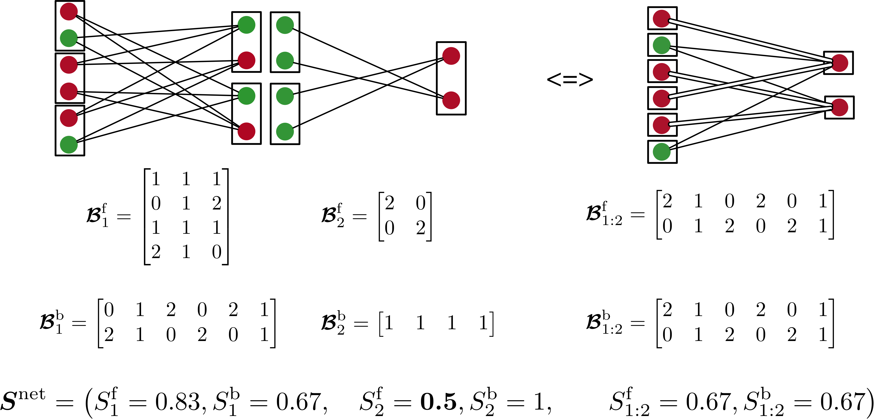
Windowed Biadjacency Matrices and Scatter
Notes:
#windows = din (forward) or dout (backward)

Slide 45
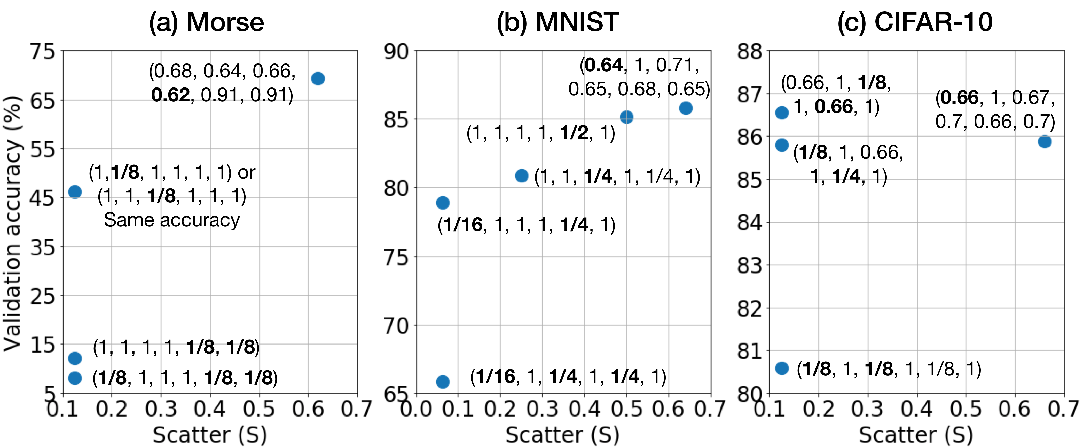
Scatter – Performance prediction before training
Not explicitly planning connections performs the best
... ties in with proposed research on model search
Scatter can help in filtering out bad networks before training … (work in progress)

Slide 46
Outline
Pre-Defined Sparsity
Introduction and Background
Hardware Architecture
Connection Patterns
Dataset Engineering
Model Search
Achieved Research Contributions

Slide 47
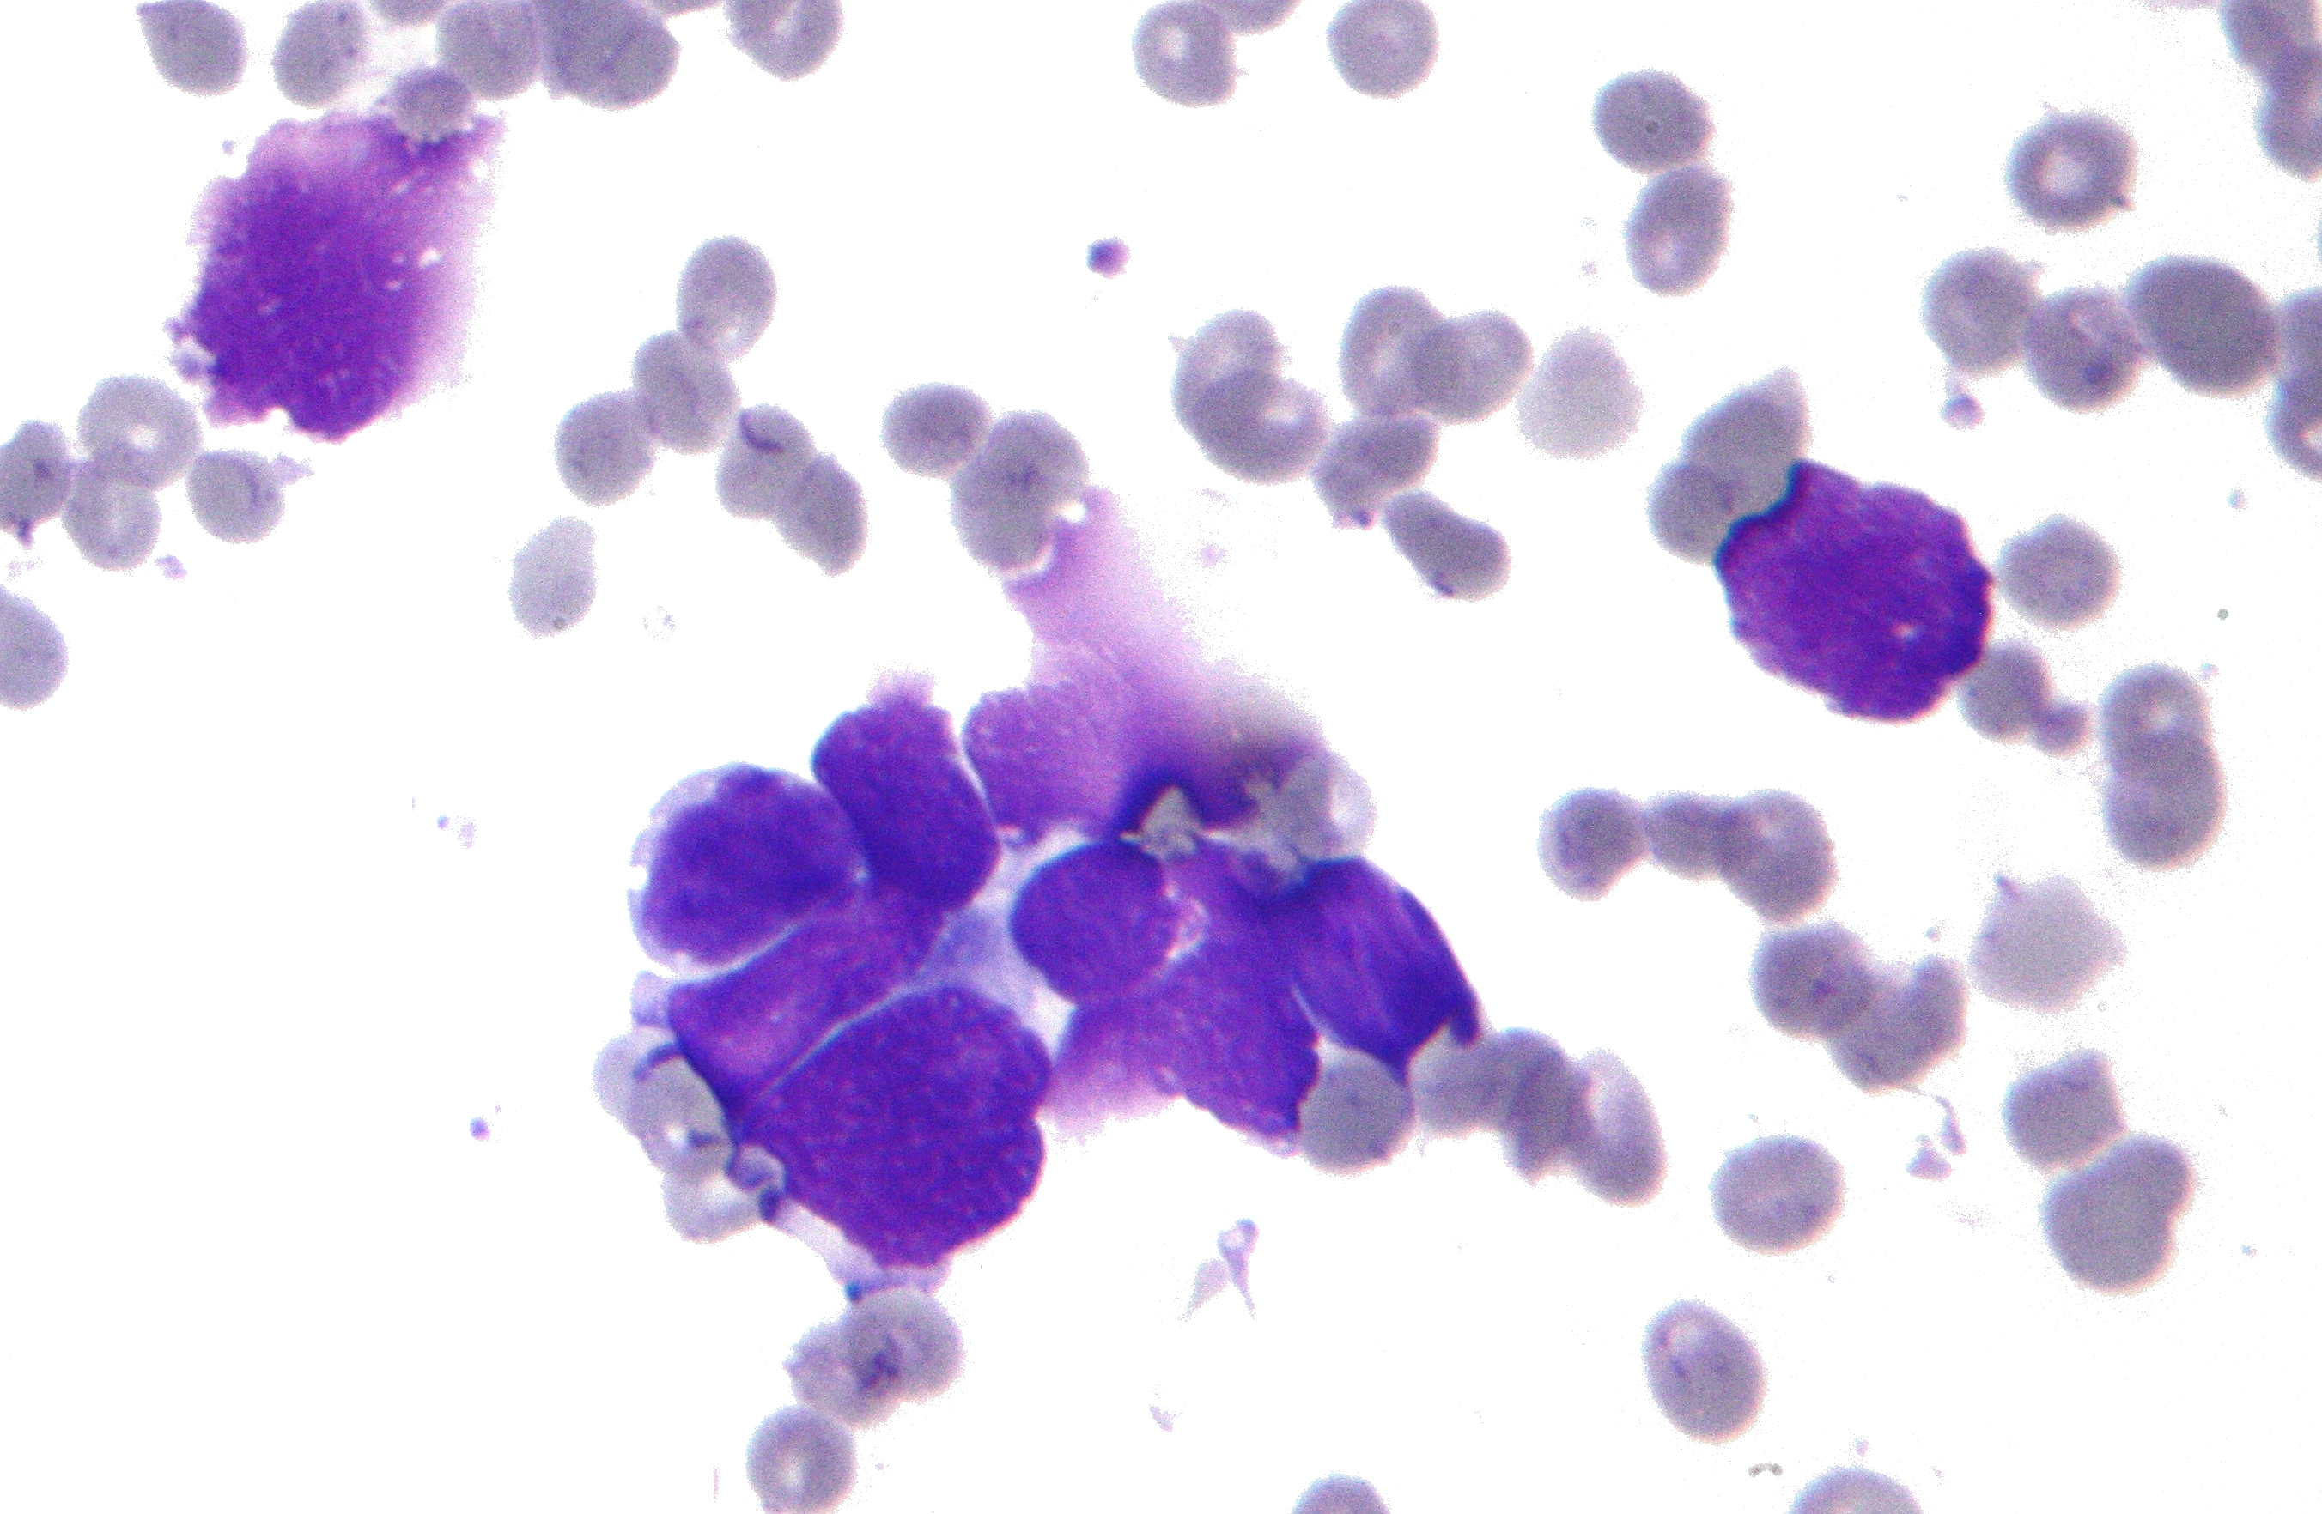
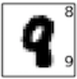
Data, data, everywhere, Not quality enough to use
Real world data has challenges:
Too few samples
Incorrect labeling
Missing entries
13.2 | 0.05 |  | 1200
10.9 |  | A
 | 0.78 | B+ | 1400
11.4 |  |  | 1100
Synthetic data is generated using computer algorithms
Very large quantities can be generated
Mimic real-world data as desired
Classification difficulty tweaking
Notes:
Middle image is Wisconsin breast cancer dataset with <600 samples

Slide 48
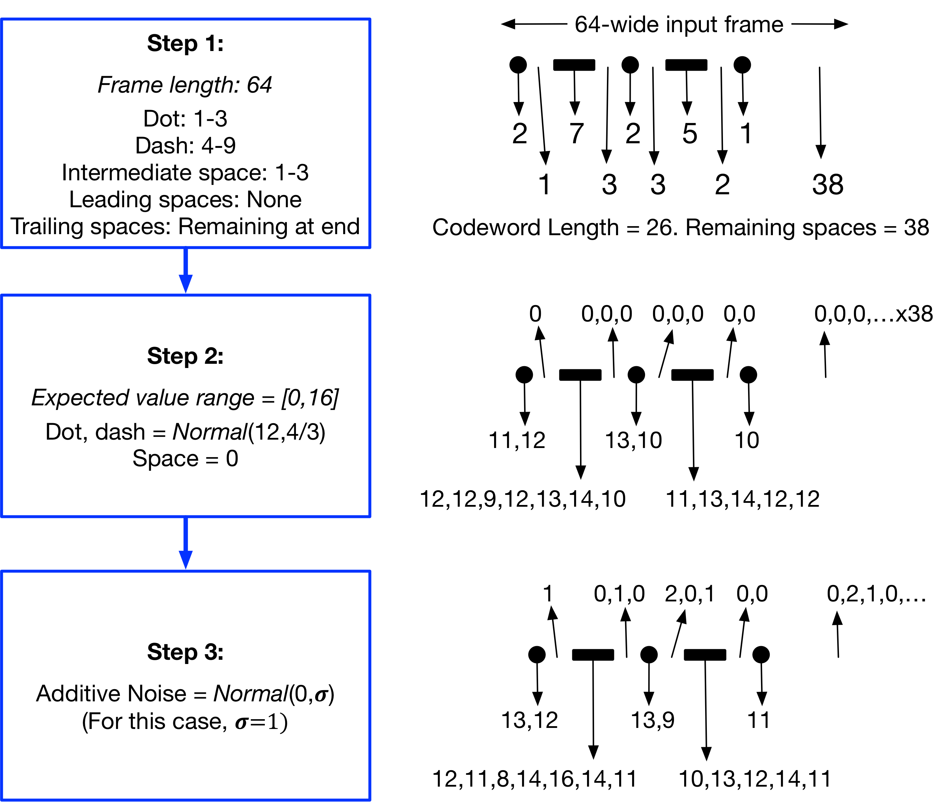
Morse Code Datasets
Morse Code is a system of communication where letters, numbers and symbols are encoded using dots and dashes
Example:
+ · - · - ·

Slide 49
Morse Code Datasets
Morse Code is a system of communication where letters, numbers and symbols are encoded using dots and dashes
Example:
+ · - · - ·

Slide 50
Morse Code Datasets
Morse Code is a system of communication where letters, numbers and symbols are encoded using dots and dashes
Example:
+ · - · - ·

Slide 51
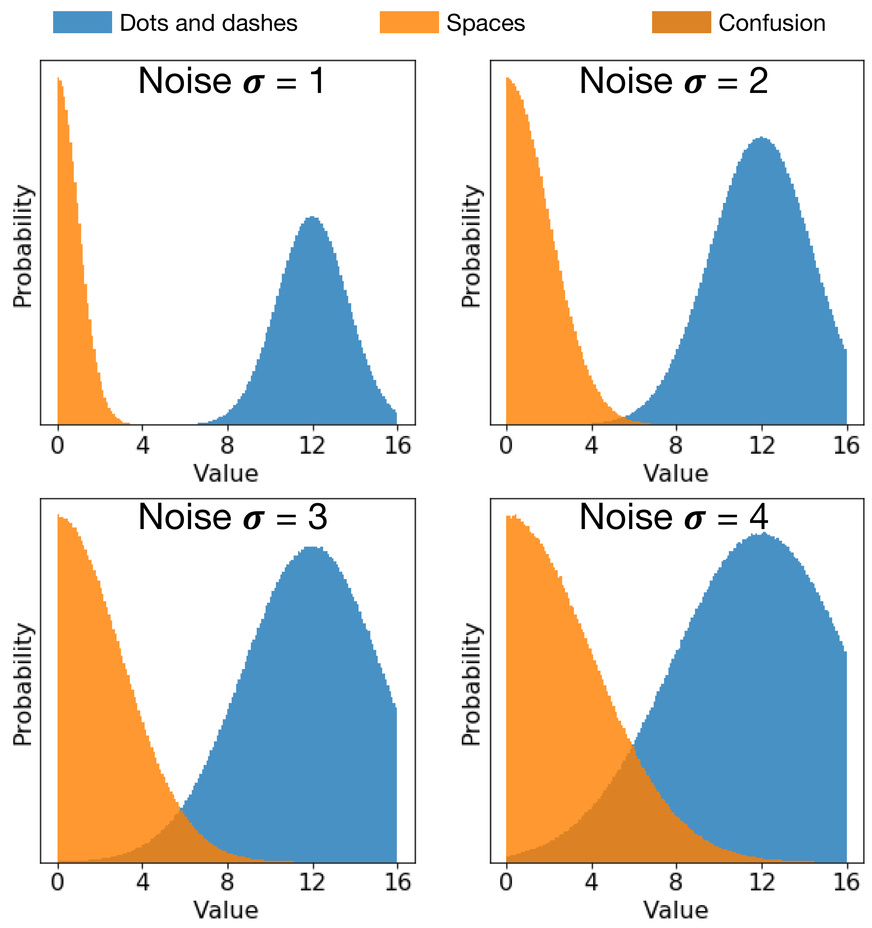
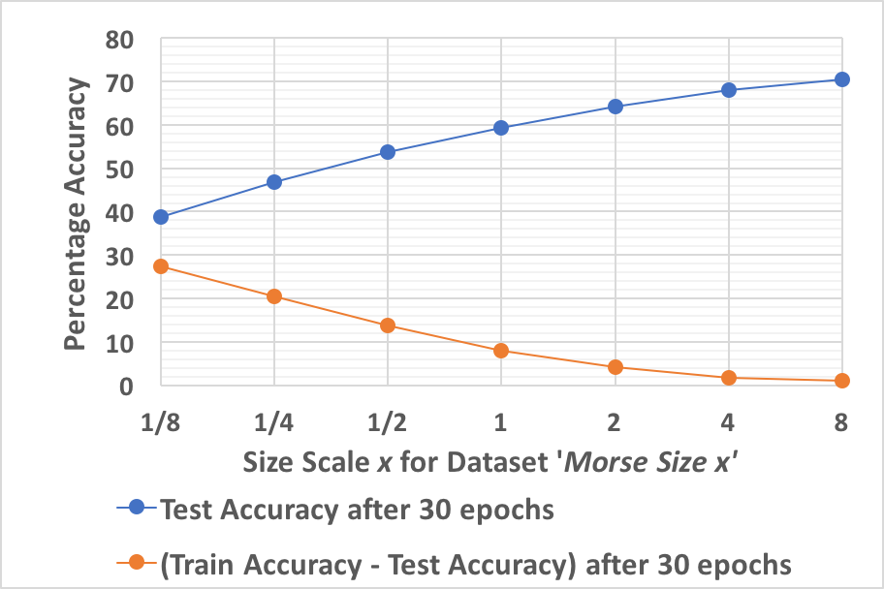
Variations and Difficulty Scaling
More noise
Leading and trailing spaces
Confusing dashes with dots and spaces
Dilating frame to size 256
Increasing #samples in dataset

Slide 52
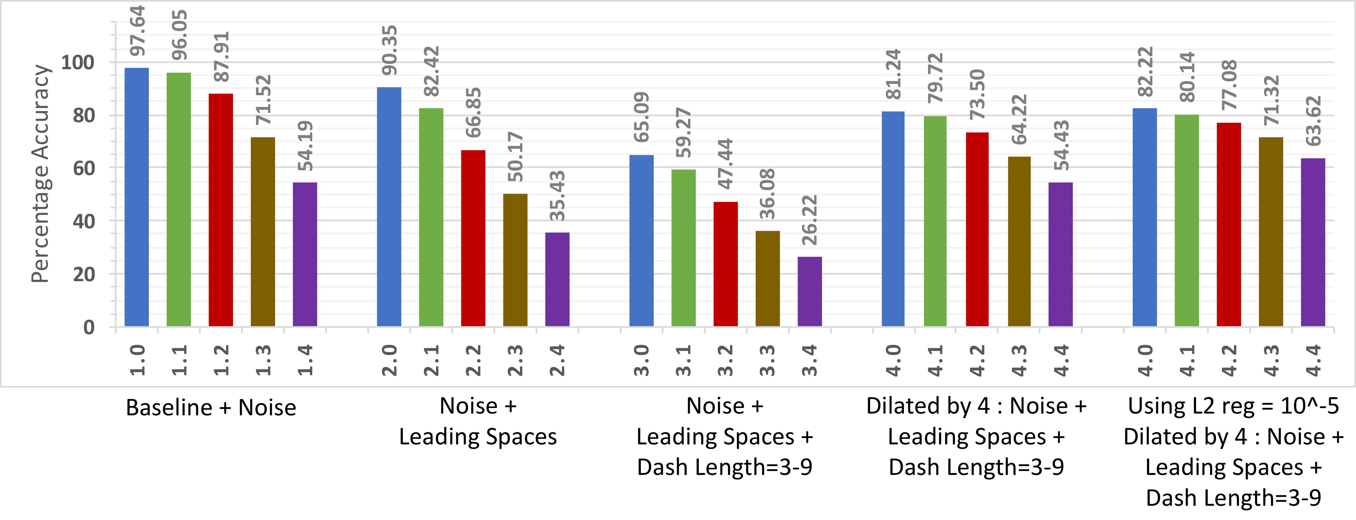
Neural network performance
Tunable dataset difficulty leads to a variety of benchmarks

Slide 53
Metrics to characterize dataset difficulty
Minimum distance between centroids of mth class and any other class
Probability of the mth class occurring
Gaussian Q-function
Average variance across all features in mth class
Distance between centroids of mth and jth classes
#classes
#features

Slide 54
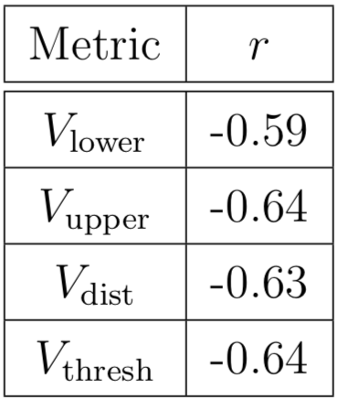
Goodness of the Metrics
Pearson’s correlation coefficient between metric and test set classification accuracy of Morse code datasets of varying difficulty
(negative because metrics indicate difficulty)
Metrics can be used to understand the inherent difficulty of the classification problem on a dataset before applying any learning algorithm

Slide 55
Outline
Pre-Defined Sparsity
Introduction and Background
Hardware Architecture
Connection Patterns
Dataset Engineering
Model Search
Proposed Research

Slide 56
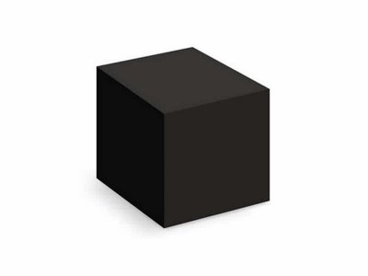
Introduction to Model Search?
Neural networks are largely black boxes
How do they work?
Are so many layers and neurons really needed?
Which parts of a network are the most important?
How should different layers be connected?
What are good hyperparameter values?

Slide 57
Types of Model Search
Model Search
Architecture Search
Evolutionary Algorithms
Reinforcement Learning
Hyperparameter Optimization
Search
Focus on small pieces of the network, mutate them to get better pieces, combine
Scheduling
Use Q-learning or policy gradient methods to select new networks to try out
Other Approaches
Fancy early stopping, predicting performance before training
Algorithms to decide good initial values of hyperparameters
Dynamically adjust values of important hyperparameters as network learns
(Network structure, layers, connection patterns, …)
(Learning rate, regularization, …)

Slide 58
Related Work
Model Search
Architecture Search
Evolutionary Algorithms
Reinforcement Learning
Hyperparameter Optimization
Search
Miikkulainen 2017 – Evolving DNNs
Liu 2018 – Hierarchical Representations
Real 2018 – Regularized Evolution
Scheduling
Zoph 2016 – NAS
Baker 2017 – Designing NN Architectures using RL
Pham 2018 – ENAS
Other Approaches
Liu 2017 – Progressive NAS
Baker 2018 – Accelerating NAS using Performance Prediction
Liu 2018 – DARTS
Bergstra 2012 – Random search
Bergstra 2013 – Making a Science of Model Search
Snoek 2012 – Bayesian optimization
Smith 2017 – Cyclical learning rates
Loschilov 2017 – SGDR
Goyal 2017 – Accurate, large minibatch SGD
Total ‘GPU days’ for finding a good architecture can be >100

Slide 59

Our Proposed Research
Architecture search with focus on low complexity networks
Extend complexity reduction methods like pre-defined sparsity to other networks beyond MLP
Lower complexity networks can train faster (sparse libraries)
Democratize architecture search to entities without enormous finances
Deeper understanding of neural networks
Build on trends and guidelines for sparsity
Which parts of a network are important – leverage evolutionary algorithms
Build on scatter-like methods to predict performance prior to training
More informed early stopping – software and hardware monitors
GOAL: Automate the process of designing well-performing, low complexity sparse neural networks for various applications

Slide 60
Summary of Contributions
Achieved:
Proposing and analyzing pre-defined sparsity to reduce NN complexity
Hardware architecture to leverage pre-defined sparsity
Analyzing connection patterns and performance predicting measures
Proposed:
Better pipelining to improve hardware architecture
Family of synthetic datasets on Morse code with tunable difficulty
Architecture search and understanding of low complexity neural networks
[Time and resources permitting] Hyperparameter search tuned to low complexity neural networks

Slide 61

Thank you!

